Slide 1
The Traveling Salesman
Starring: Mr. Brute Force
Co Starring: Mrs. Sorted Edge
Lord Nearest Neighbor

Slide 2
The Problem:
As you approach the legal driving age you realize you need to start earning some money so that you won’t have to rely on your tricycle any more.
You decide to go into business for yourself and start your own paper route. You start small, with only 3 customers.

Slide 3
The Problem:
The following table represents the time, in minutes, for you to ride you tricycle between each of your customer homes, and yours.

Slide 4
The Problem:
Home Aldo Butch Cassidy
Home -- 6 12 5
Aldo 6 -- 8 9
Butch 12 8 -- 13
Cassidy 5 9 13 --

Slide 5
The Problem:
Create a program that will display the shortest (time-wise) route for you to take.

Slide 6
Algorithms to code:
Brute Force: Create a Tree diagram, analyzing all possible paths and pick the shortest.

Slide 7
Algorithms to code:
Nearest Neighbor: Starting from Home, go to the “nearest” neighbor (the neighbor whose house is closest), and then to that person’s “nearest” neighbor, and so on, until it is time to return home. No customer can be visited twice.

Slide 8
Algorithms to code:
Sorted-Edges / Cheapest-Link: Select paths one at a time, always selecting the “cheapest” path. Continue in this manner, unless picking a path will “close” your route (close a circuit) before reaching all your customers, or it will be a third path/edge chosen to a customer’s house.

Slide 9
The user will select the algorithm to be used.
Your home and your customers are mathematically represented by a graph, or a network of vertices and edges connecting the vertices. One possible graph representing the above situation is pictured

Slide 10
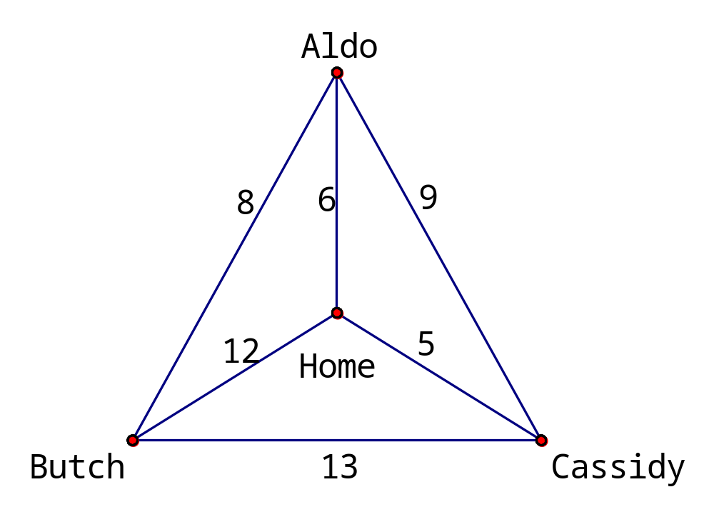

Slide 11
Upgrades:
User selects start location.
Not all locations are connected
File I/O for larger networks.

Slide 12
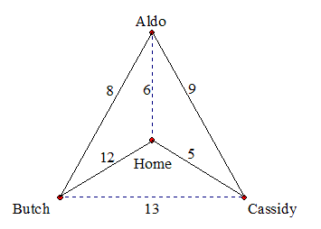

Slide 13
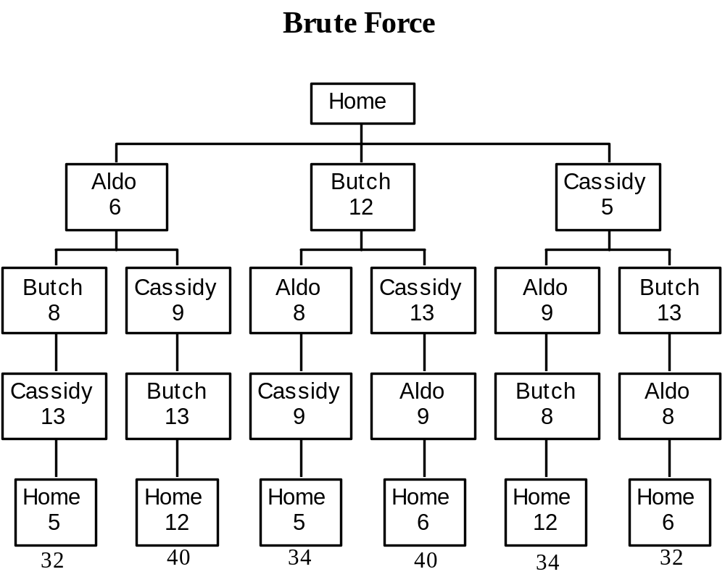
Brute Force:

Slide 14
The first and last paths are the shortest, each taking 32 minutes.
Note that the order of H-A-B-C-H is the reverse of H-C-B-A-H

Slide 15
Nearest Neighbor:
Start at HOME
Look for Shortest Path and take it
From the new location, look for the shortest path left and take it
Then, select the next shortest path (unless it takes you home before all locations have been visited)
If there are no other locations to visit, go home
Sum up the time for all paths taken

Slide 16
The Nearest-Neighbor Algorithm yields a path of H-C-A-B-H or H-B-A-C-H.
Note that these paths are 34 minutes long – this is not the optimal solution, but still a good solution.

Slide 17
Sorted-Edges / Cheapest Link:
Start by sorting the edges smallest to largest
5
6
8
9
12
13

Slide 18
Sorted-Edges / Cheapest Link:
Go down the list, selecting the shortest available path that does not close a circuit (unless you’re done) and it is not the third path/edge leading to a customer/vertex.

Slide 19
Sorted-Edges / Cheapest Link:
Note that this algorithm produced a path of
H-A-B-C-H (or H-C-B-A-H)
which takes 32 minutes and is our optimal path.

Slide 20
Your Task is to implement the Nearest Neighbor & Sorted Edges algorithms
Maximum points will be awarded for those who implement an algorithm that provides for a dynamically set of locations
We will modify this project to make use of file I/O after our next lecture topic is covered

